Slide 1

AASD 4004
Machine Learning - II
Applied AI Solutions Developer Program

Slide 2
Module 04 Information Extraction
Vejey Gandyer

Slide 3
Agenda
Information Extraction
IE Pipeline
Key Phrase Extraction
Named Entity Recognition
Named Entity Disambiguation & Linking
Relation Extraction
Event Extraction ?????

Slide 4
Information Extraction
What is it?

Slide 5
Information Extraction
Refers to the NLP task of extracting relevant information from text documents
Information - Key events, entities, people, relationships, ...
Types
Key Phrase Extraction
Named Entity Recognition
Named Entity Disambiguation & Linking *
Relation Extraction *
Event Extraction *
* - Will be seen in DL-I

Slide 6
IE Pipeline

Slide 7
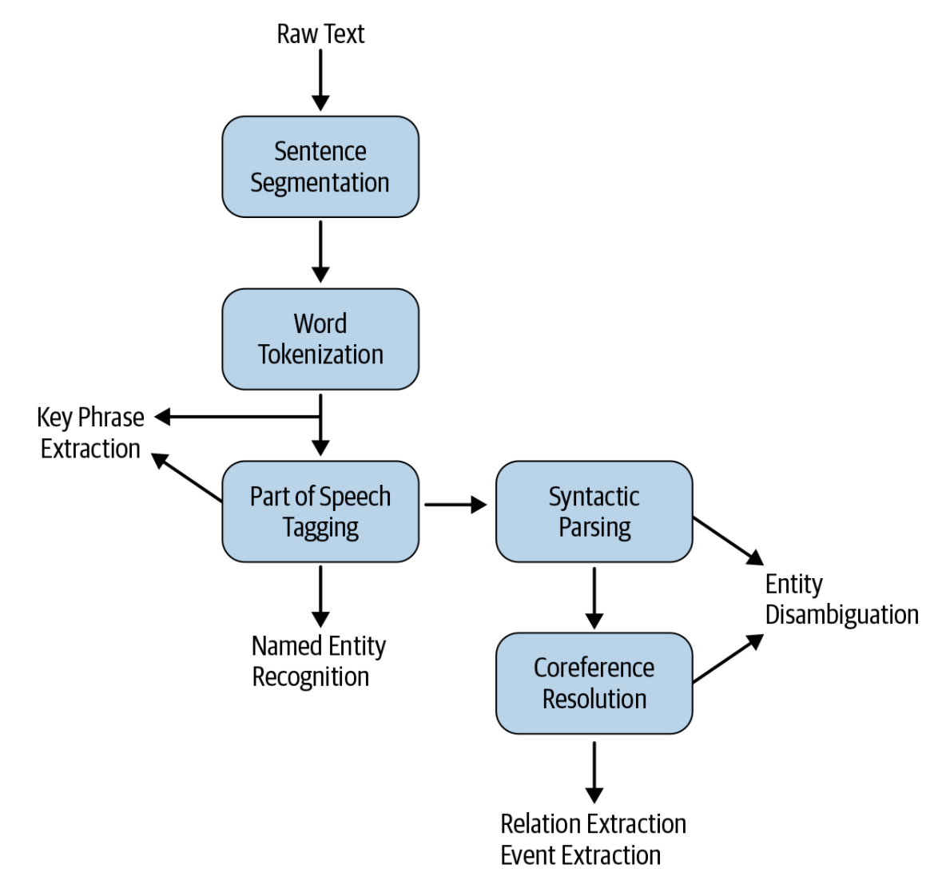
IE Pipeline

Slide 8
Key Phrase Extraction

Slide 9
Key Phrase Extraction
Task of extracting important words and phrases that capture the gist of the text from a given text document
Applications
Information retrieval
Automatic document tagging
Recommendation system
Text summarization
Approaches
Supervised
Needs labeled data
Time-consuming labeling process
Unsupervised
No labels needed

Slide 10
Key Phrase Extraction - Unsupervised
Based on Graph approach
Node - Keywords
Edge - Weights (importance)
Top-N keywords are those nodes with well connected with other nodes

Slide 11
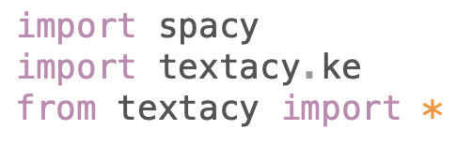
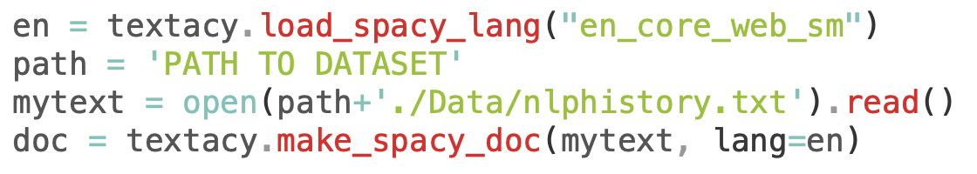
Key Phrase Extraction - textacy

Slide 12
Key Phrase Extraction - textacy
The process of extracting potential n-grams and building the graph with them is sensitive to document length, which could be an issue in a production scenario. One approach to dealing with it is to not use the full text, but instead try using the first M% and the last N% of the text, since we would expect that the introductory and concluding parts of the text should cover the main summary of the text.
Since each keyphrase is independently ranked, we sometimes end up seeing overlapping keyphrases (e.g., “buy back stock” and “buy back”). One solution for this could be to use some similarity measure (e.g., cosine similarity) between the top-ranked keyphrases and choose the ones that are most dissimilar to one another. textacy already implements a function to address this issue, as shown in the notebook.
Seeing counterproductive patterns (e.g., a keyphrase that starts with a preposition when you don’t want that) is another common problem. This is relatively straightforward to handle by tweaking the implementation code for the algorithm and explicitly encoding information about such unwanted word patterns.
Improper text extraction can affect the rest of the KPE process, especially when dealing with formats such as PDF or scanned images. This is primarily because KPE is sensitive to sentence structure in the document. Hence, it’s always a good idea to add some post-processing to the extracted key phrases list to create a final, meaningful list without noise.

Slide 13
Named Entity Recognition
NER

Slide 14
Named Entity Recognition - Motivation
Where was Albert Einstein born?
Answer: Ulm, Germany
Albert Einstein --> Entity (PERSON)
NER refers to the task of identifying entities in a document

Slide 15
Named Entity Recognition using spaCy
SpaCy - Built-in NER capability
Issues
- No custom entities can be detected apart from PERSON, PLACE, ORG and so on
- Unusal Sentence Splitting (sometimes)

Slide 16
Custom Named Entity Recognition System
Import necessary libraries
Load the dataset - CONLL
Extract features
Train CRF model
Evaluate CRF model

Slide 17
Named Entity Disambiguation & Linking
NED & NEL

Slide 18
Named Entity Disambiguation (NED)
Lincoln drives a Lincoln Aviator and lives on Lincoln Way
All three mentions of "Lincoln" refers to different entities
NED refers to tha task of assigning a unique identity to entities mentioned in the text. It maps to corresponding Knowledge Bases (Google Knowledge Graph, Wikipedia Knowledge Graph, …)

Slide 19
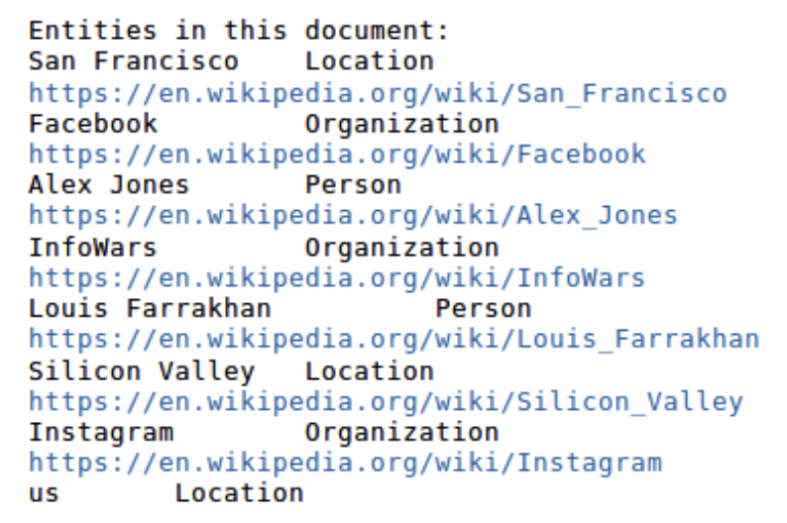
Named Entity Linking (NEL)
NEL = NER + NED
Azure Text Analytics API performs NEL
Input: Text
Output: Entities detected with its corresponding Wikipedia links

Slide 20
Relation Extraction
RE

Slide 21
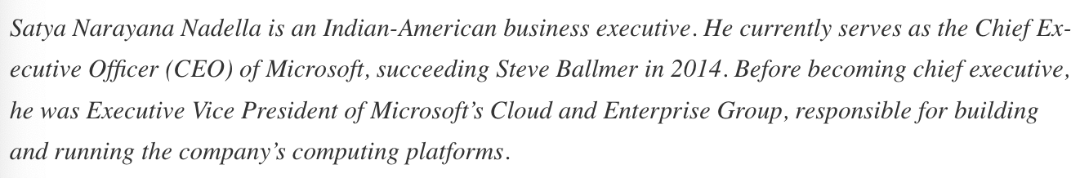
Relation Extraction
RE refers to the task of extracting entities and relationships between entities from text documents
Set of triples (Subject, verb, Object)
Include: Self- Knowledge Creation notebooks

Slide 22
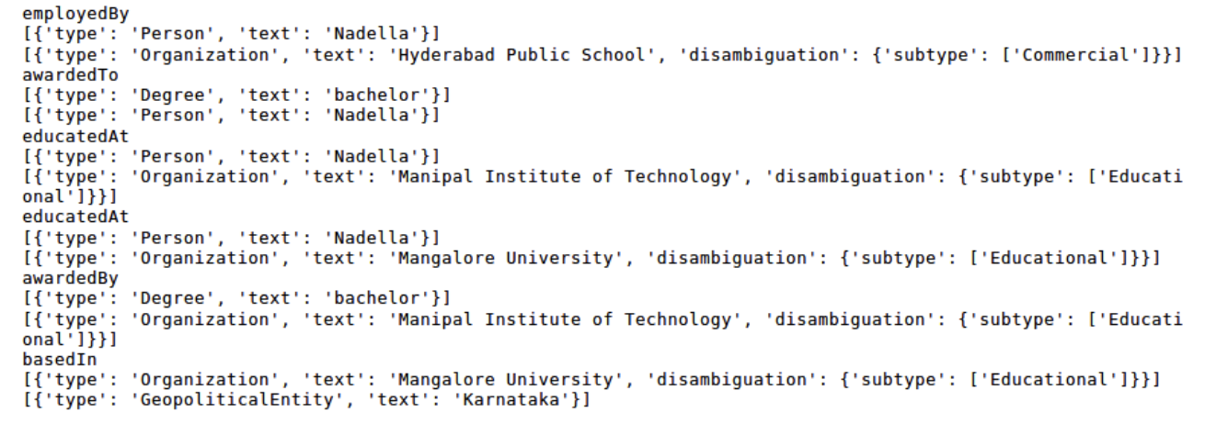
Relation Extraction using Watson API
Watson API

Slide 23
Exercise: Building an end-to-end Information Extraction System
KPE, NER

Slide 24
Building an IE System
Create an Information Extraction System that has the following features:
- KPE
- NER
- NEL*
- RE*
* DL-I

Slide 25
Further Reading
Practical Natural Language Processing
Soumya Vajjala, Anuj Gupta, Harshit Surana, Bodhisattwa Majumder

